Slide 1

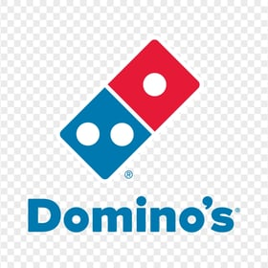
INFORMATION SYSTEM FOR MANAGERS
PRESENTED BY-
AMRISHA BARANWAL (24BSP0181)
AMAN SRIVASTAVA (24BSP0166)
VARSHA PRASAD (24BSP2220)
SIMRAN KUMARI (24BSP2467)
TOPIC – “DOMINO’S”

Slide 2
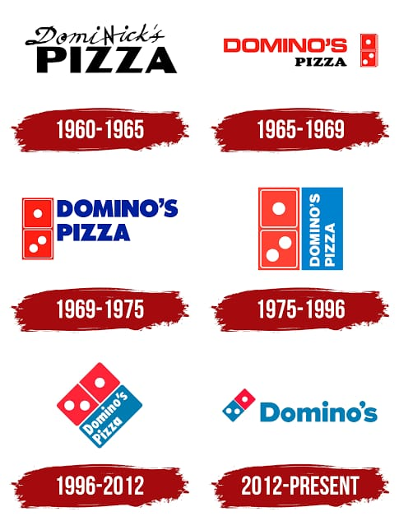
HISTORY OF DOMINO’S
Domino's Pizza, an American multinational pizza restaurant chain founded in 1960, entered the Indian market in 1996. Jubilant Food Works Limited is the master franchisee for Domino's in India. The first Domino's outlet in India opened in New Delhi IN 1996.
1996: Domino's opens its first store in New Delhi.
2000: Introduction of the "30 minutes or free" delivery guarantee,
which became a significant factor in its popularity.
2004: Launched its 100th outlet in India.
2012: Reached the milestone of 500 outlets.
2016: Celebrated its 20th anniversary in India with over 1,000
outlets.
2021: Expanded to over 1,400 stores across 293 cities in India.
2023: India had over 1,900 Domino’s Pizza stores.

Slide 3
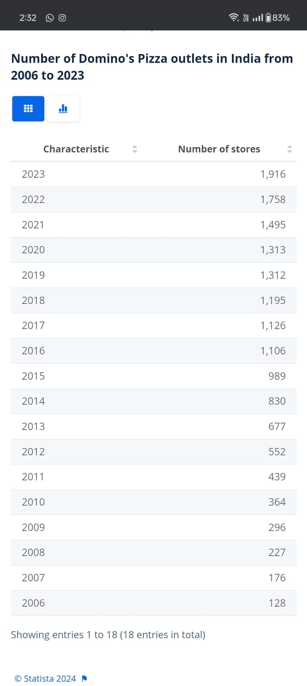
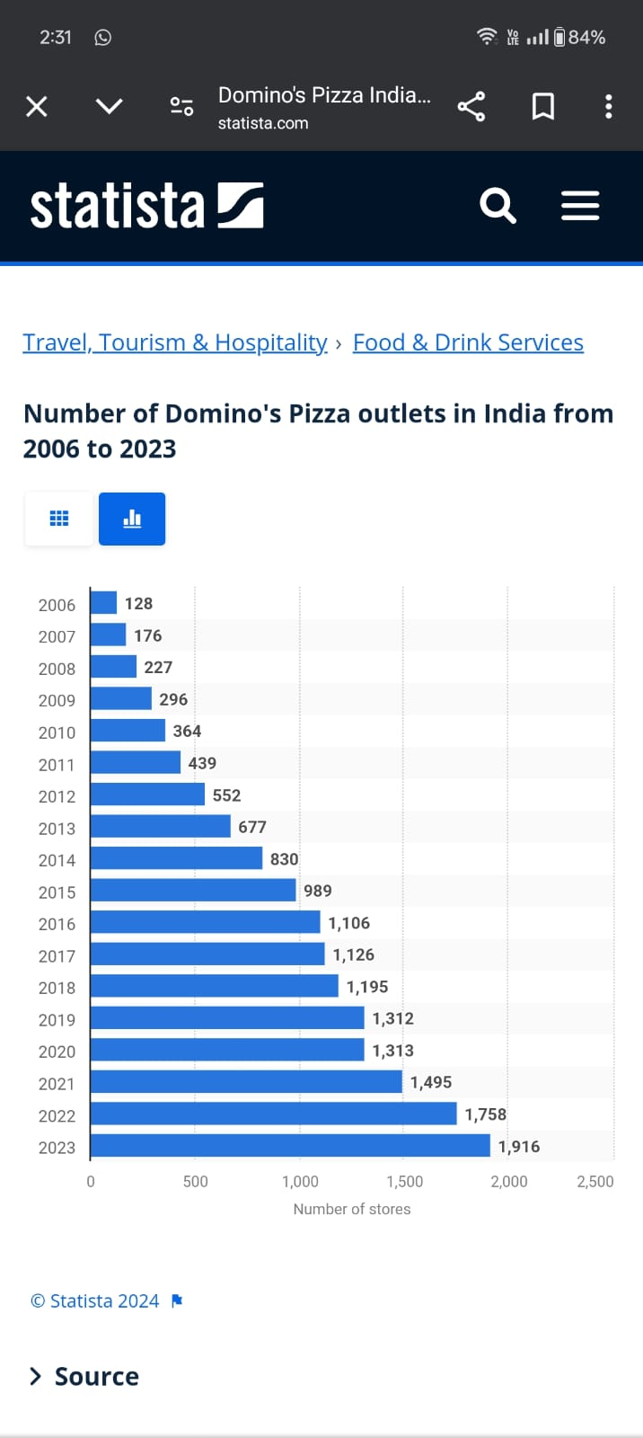
NUMBER OF DOMINO’S PIZZA OUTLETS IN INDIA FROM 2006 TO 2023

Slide 4
(TPS) Here are some key points about the transaction process at Domino's India:
ORDER PLACEMENT
ORDER CONFIRMATION
PREPARATION AND TRACKING
QUALITY CHECK
DISPATCH RECEIPT
CUSTOMER RECEIPT
PAYMENT PROCESSING
FEEDBACK AND SUPPORT

Slide 5
Planning: This phase involves defining the scope of the project, gathering requirements, and determining the feasibility of the software development. Analysis: During this phase, Domino's would conduct a detailed analysis of the requirements gathered in the planning phase. Design: In this phase, the architecture of the software system is designed. Development: Actual coding of the software begins in this phase. Developers write code according to the design specifications.
The Software Development Life Cycle (SDLC) of Domino’s:-

Slide 6
Maintenance: After deployment, the software enters the maintenance phase. Monitoring and Optimization: Throughout the lifecycle, Domino's would monitor the performance of their software, gather user feedback, and optimize the system for better efficiency, usability, and customer satisfaction. This SDLC process is iterative and may involve multiple cycles, especially as Domino's continues to innovate and improve their software systems to meet changing customer expectations and business requirements. Each phase is critical to ensuring that the software developed meets quality standards and fulfills its intended purpose effectively.

Slide 8
THANK YOU….

